Slide 1
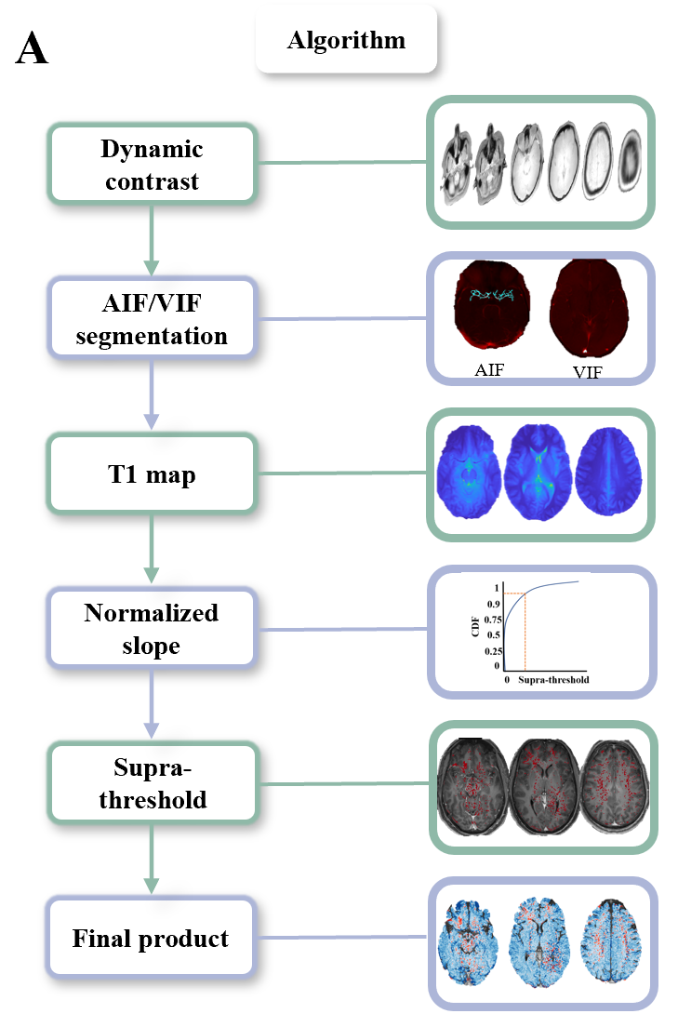
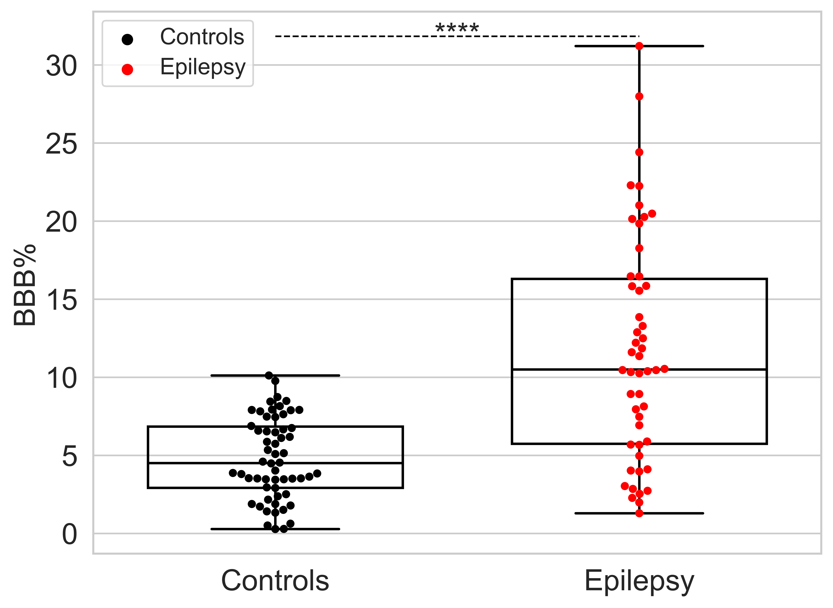
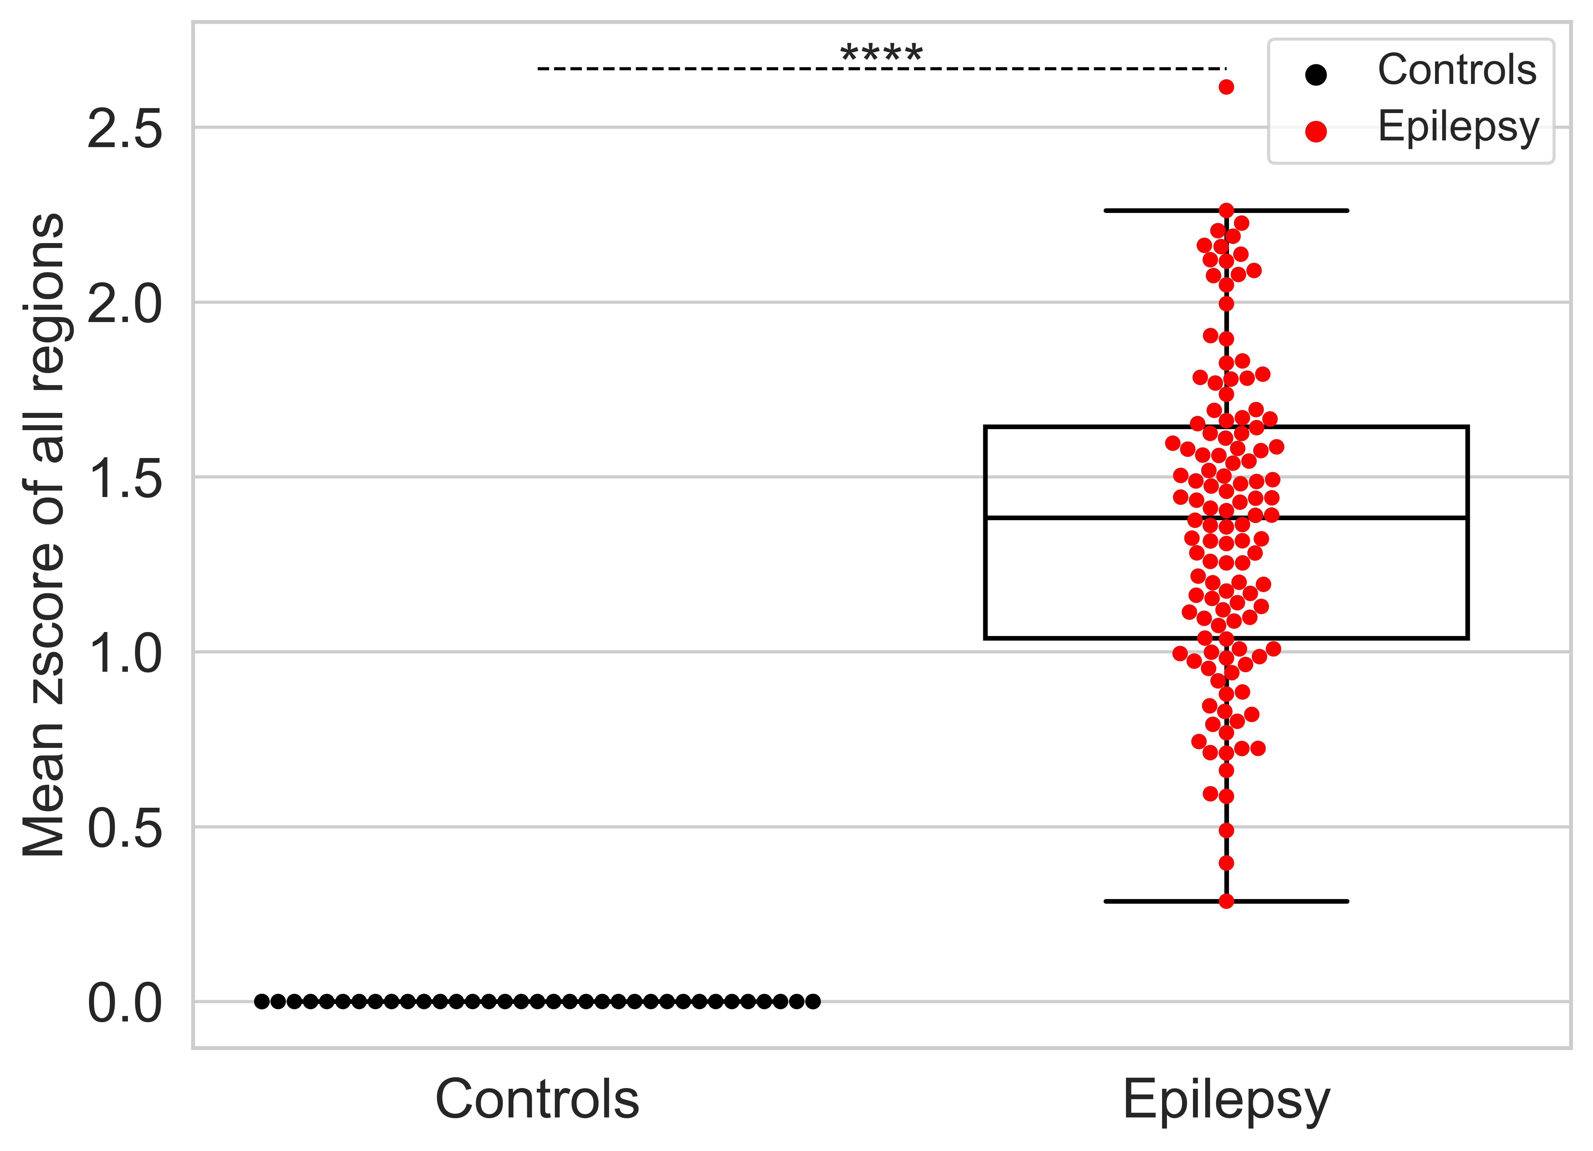
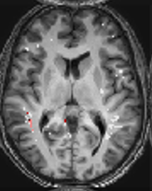
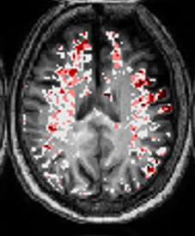
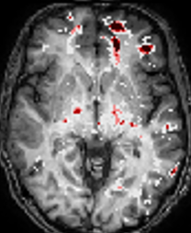
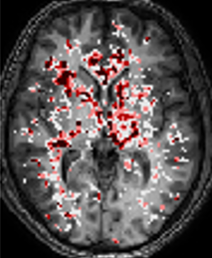
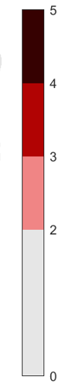




FIGURE 1: Epilepsy vs controls
A
B
E Epilepsy
C Controls
1
1 2 3
Zscore
Zscore
D
F
Figure 1 DCE-MRI reveals persistent BBBD in epileptic patients. . (A) BBBD analysis method. (B) Epileptic patients’ BBBD% and zscore above controls. (C) Examples of controls BBBD maps. (D) Examples of controls regional maps. (E) Examples of patients with epilepsy 1 – Left temporal epilepsy. 2 – Left frontal epilepsy. 3- Generalized epilepsy. (F) Examples of patients with epilepsy regional maps.
Notes:
Epilepsy 1 – EA 0804 LFT
2 - MH 4108 LF
3 - WS_7206 G
Controls
1 – AN 0207
2 – HS 5404

Slide 2
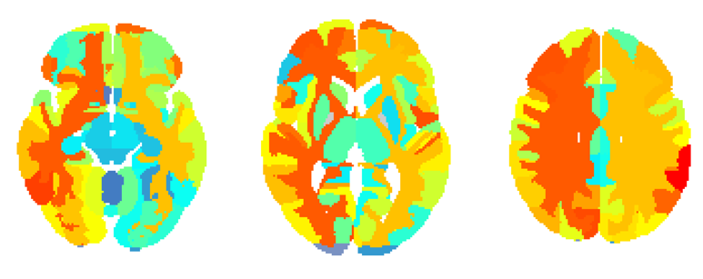
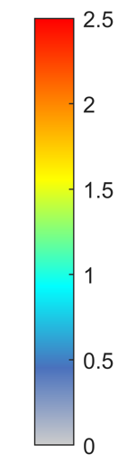
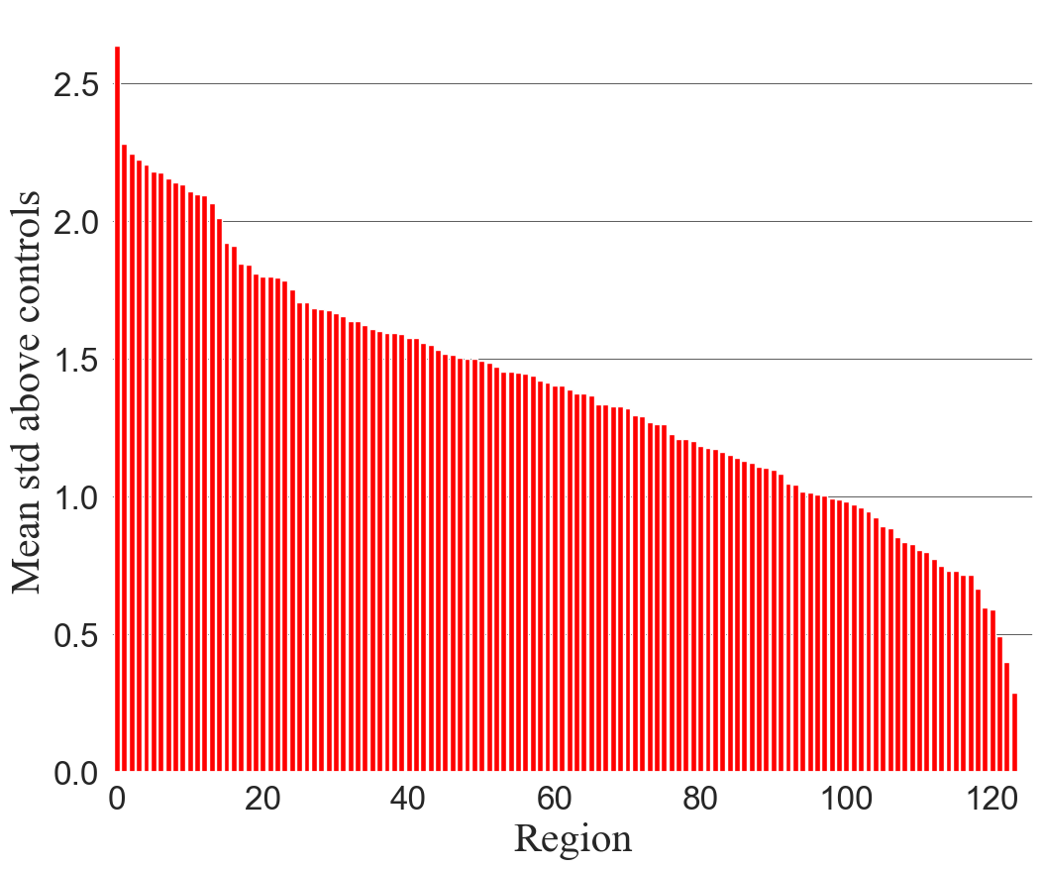
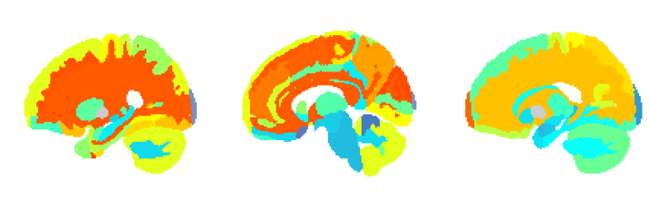
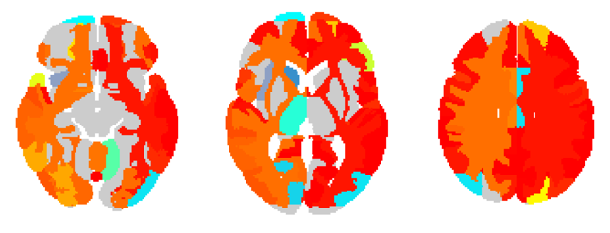
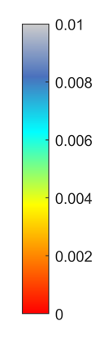
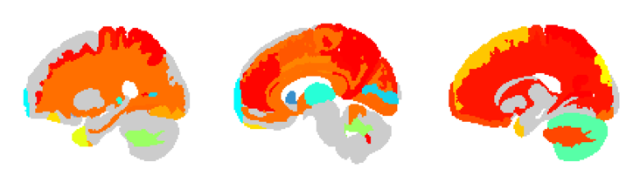
FIGURE 2: Regional analysis
A
C
Zscore
B
Zscore
P value
Figure 2 . (A) Zscore above controls in regional maps of 126 areas. (B) Significant regions of patients with epilepsy compared to controls p<0.01. (C) Zscore per region of patients with epilepsy compared to controls
Notes:
Examples:
EA 0804
LL 0265
BT 3007 – left side
Optional:
AF7084 – linear and tofts diffuse
BA 5372 – linear G and tofts F

Slide 3
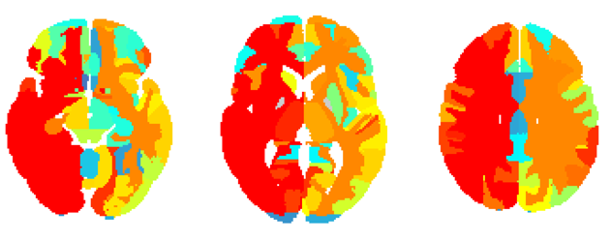
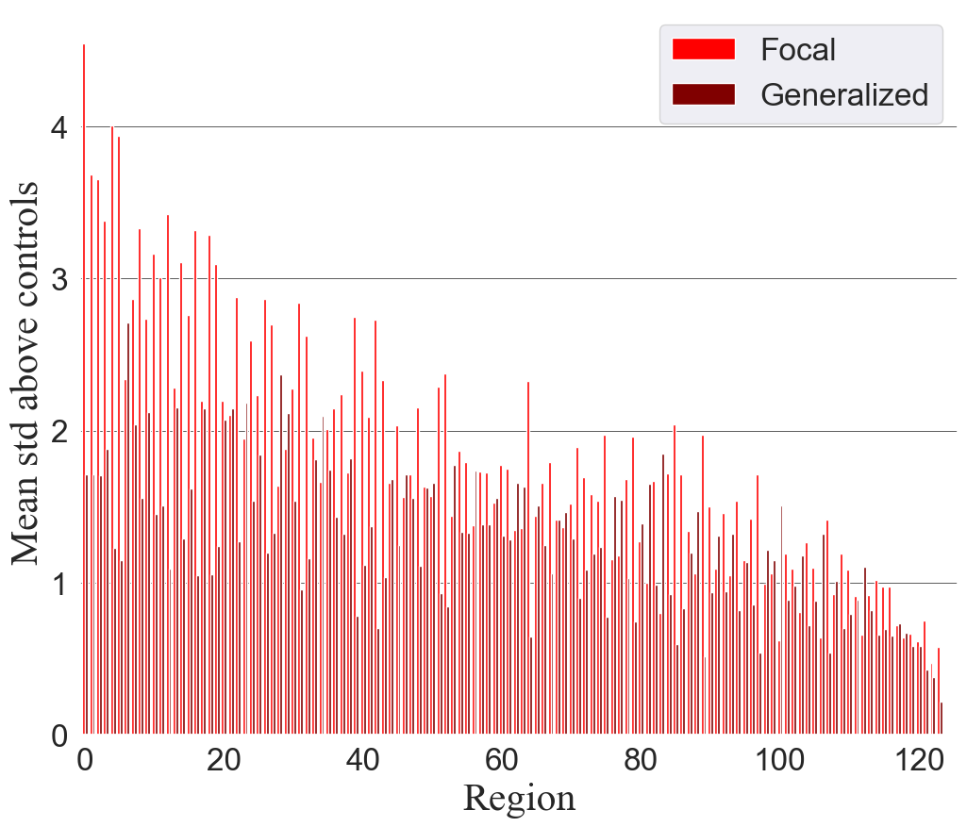
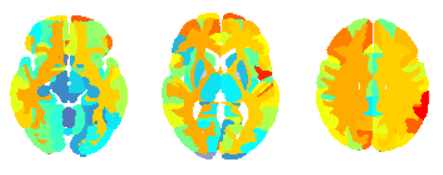
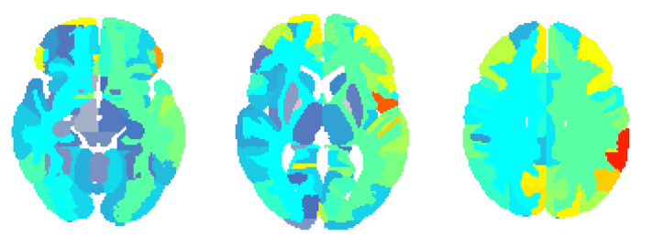
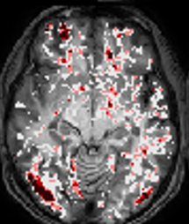

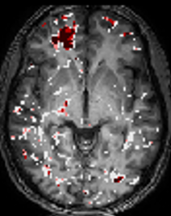

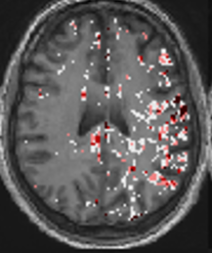

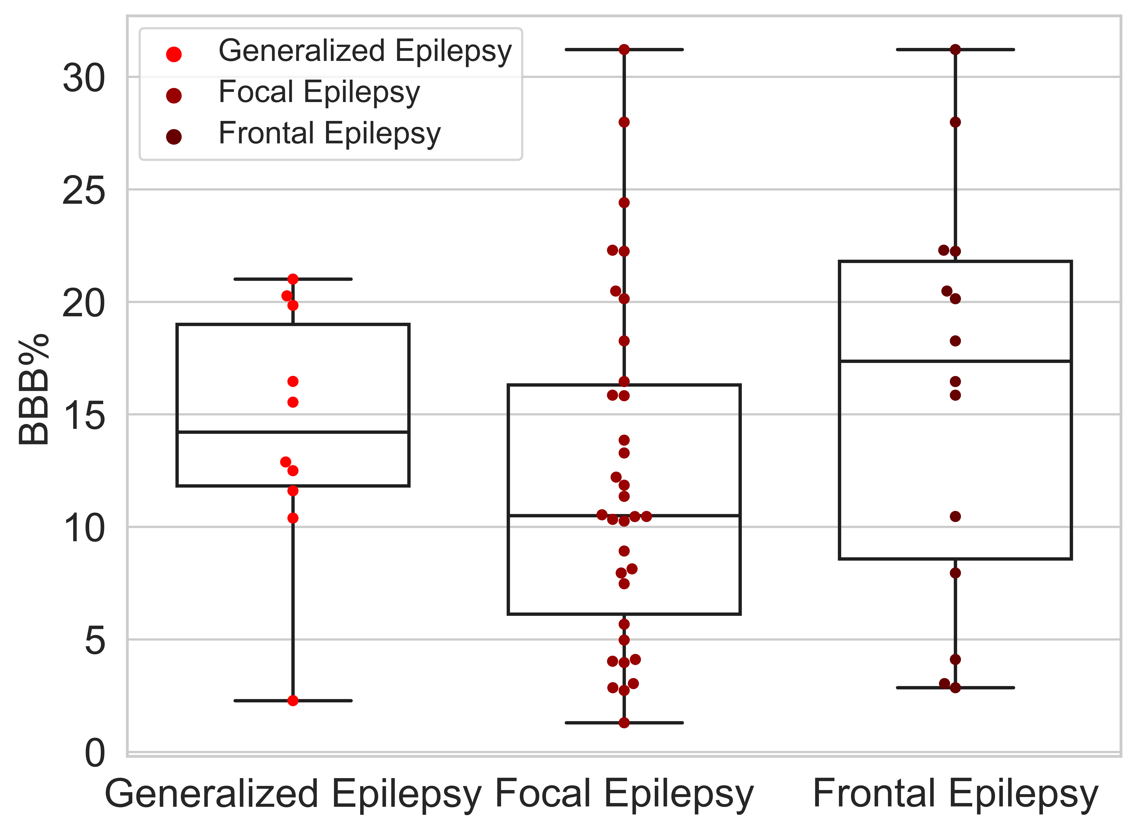
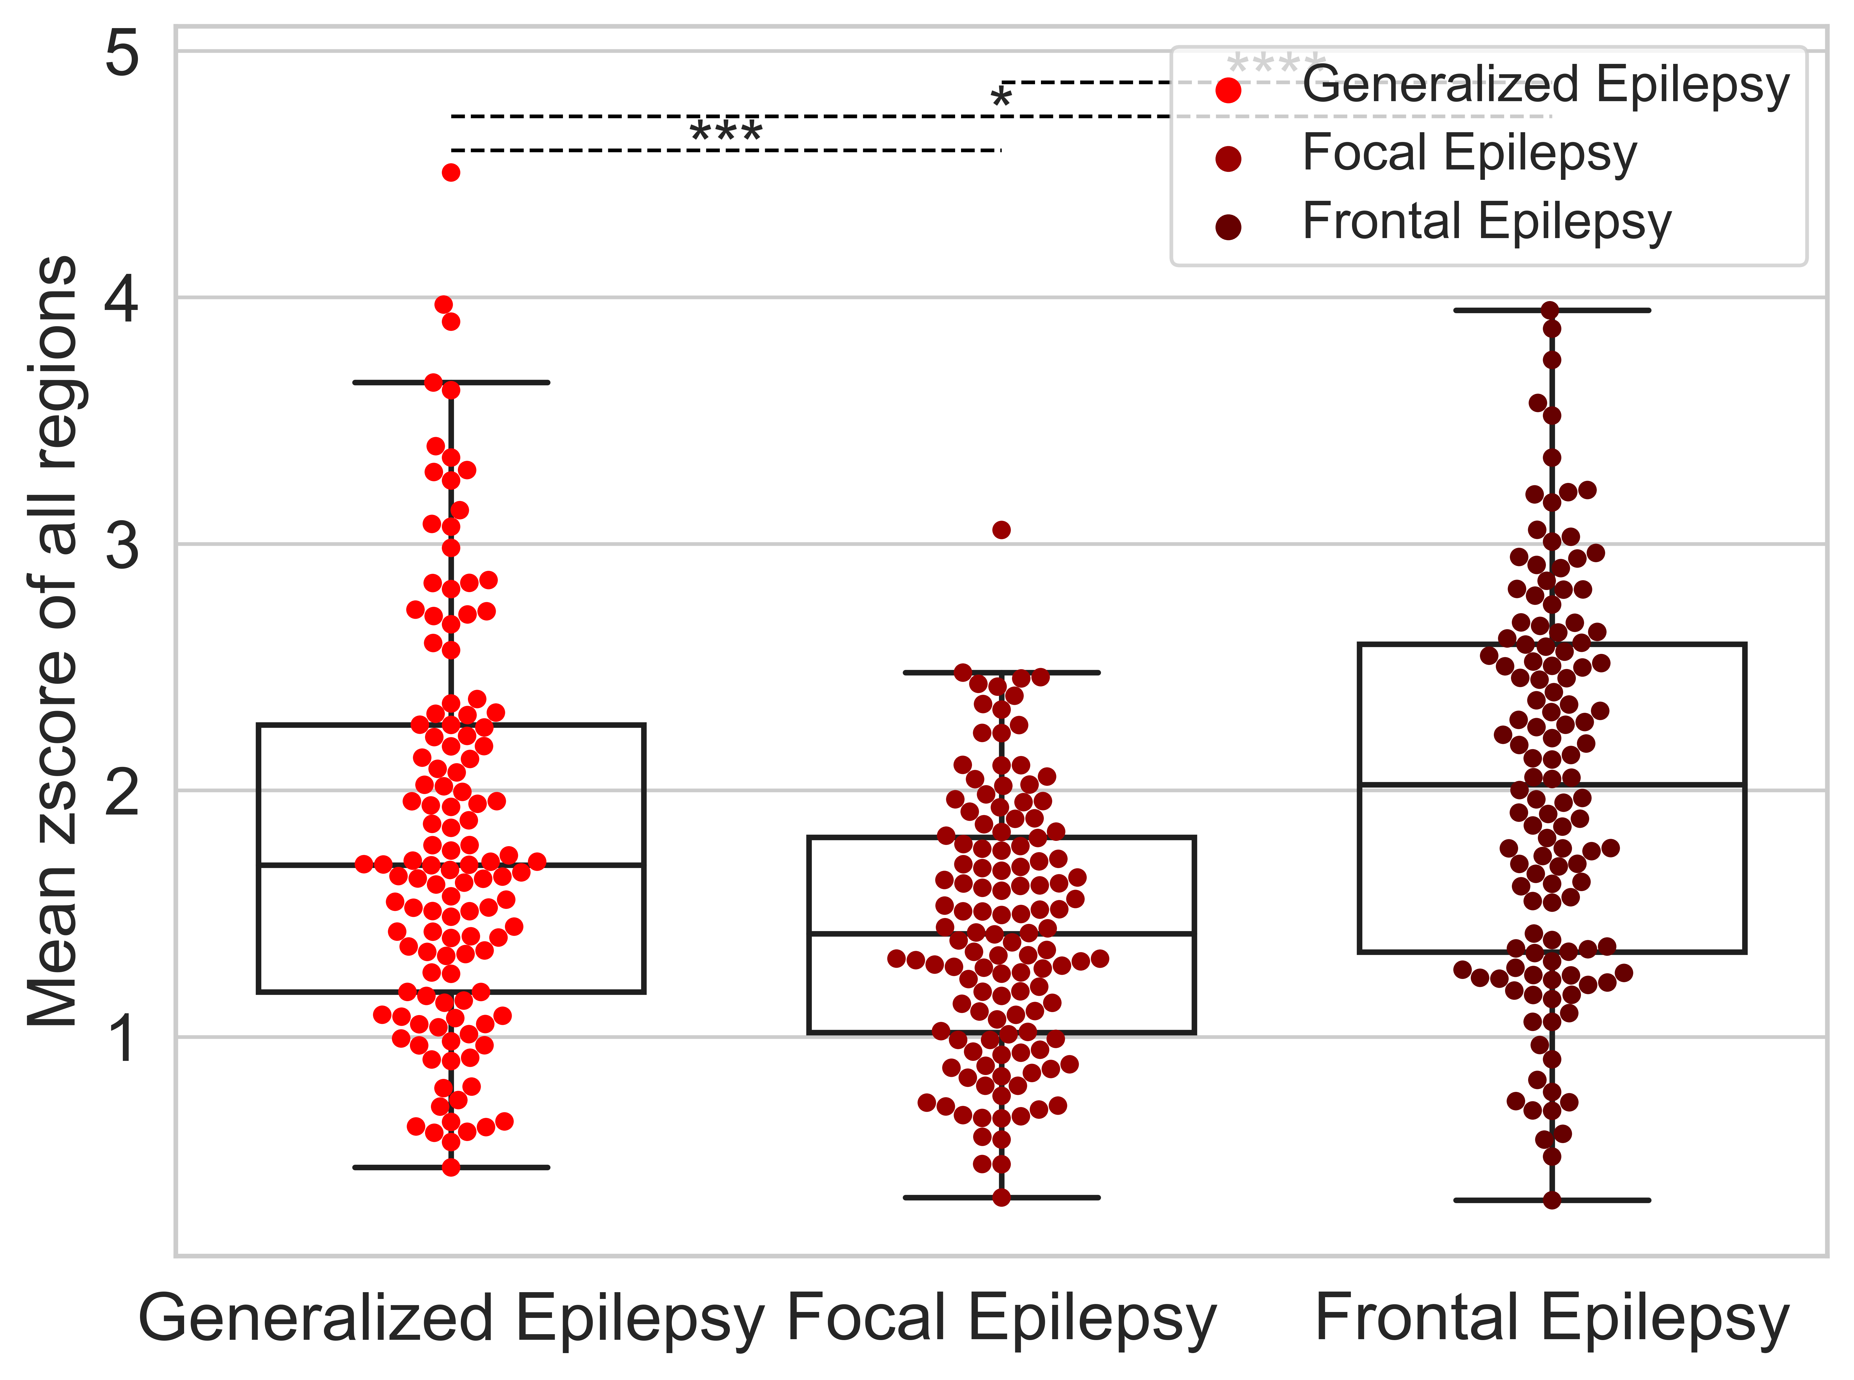
FIGURE 3: Focal vs Generalized
A Generalized
D
B Focal All
Zscore
Zscore
C Suspected temporal
E
Focal – frontal left Left temporal
Generalized
F
Figure 3 Similar BBBD behavior of slow and fast models. (A) Zscore of generalized patients with epilepsy in each region. (B) Zscore of patients with focal epilepsy in each region. (C) Zscore of patients with suspected temporal epilepsy (D) Zscore per region of focal and generalized patients with epilepsy compared to controls (F) Statistics of focal and generalized epileptic patients
Notes:
G
AE 2898
F
HY_9719
FT
IMP_011
VA 6538
LL 0265
TA 4648

Slide 4
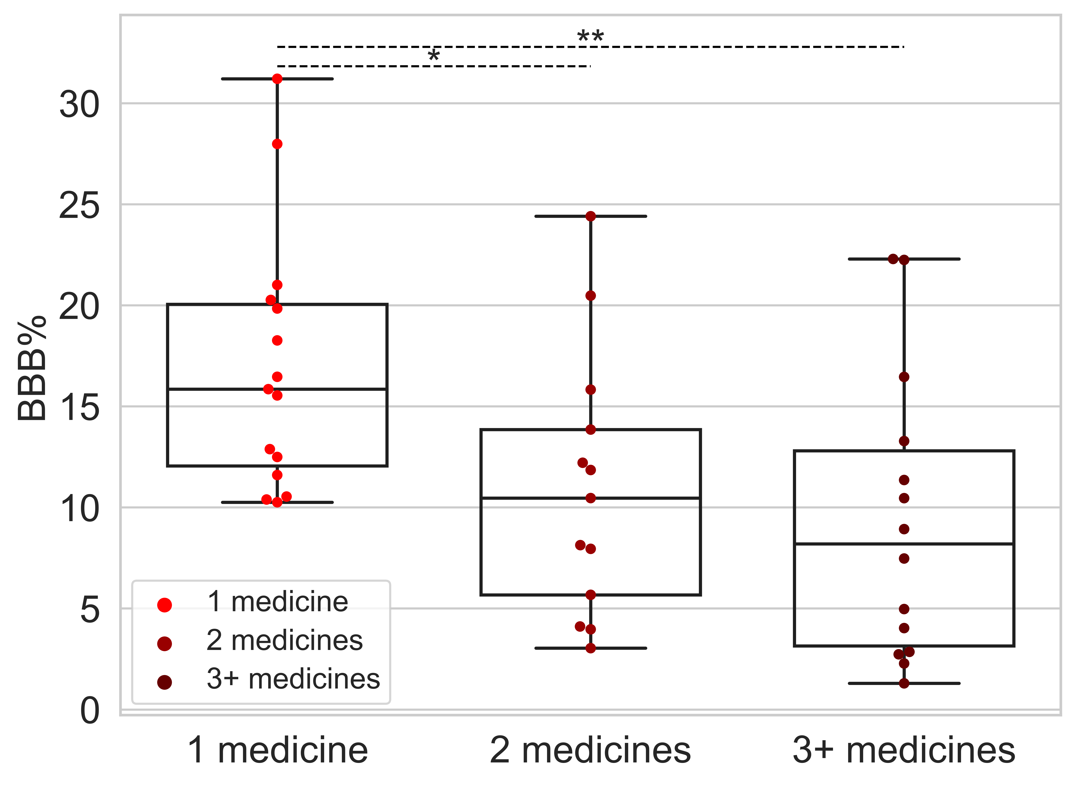
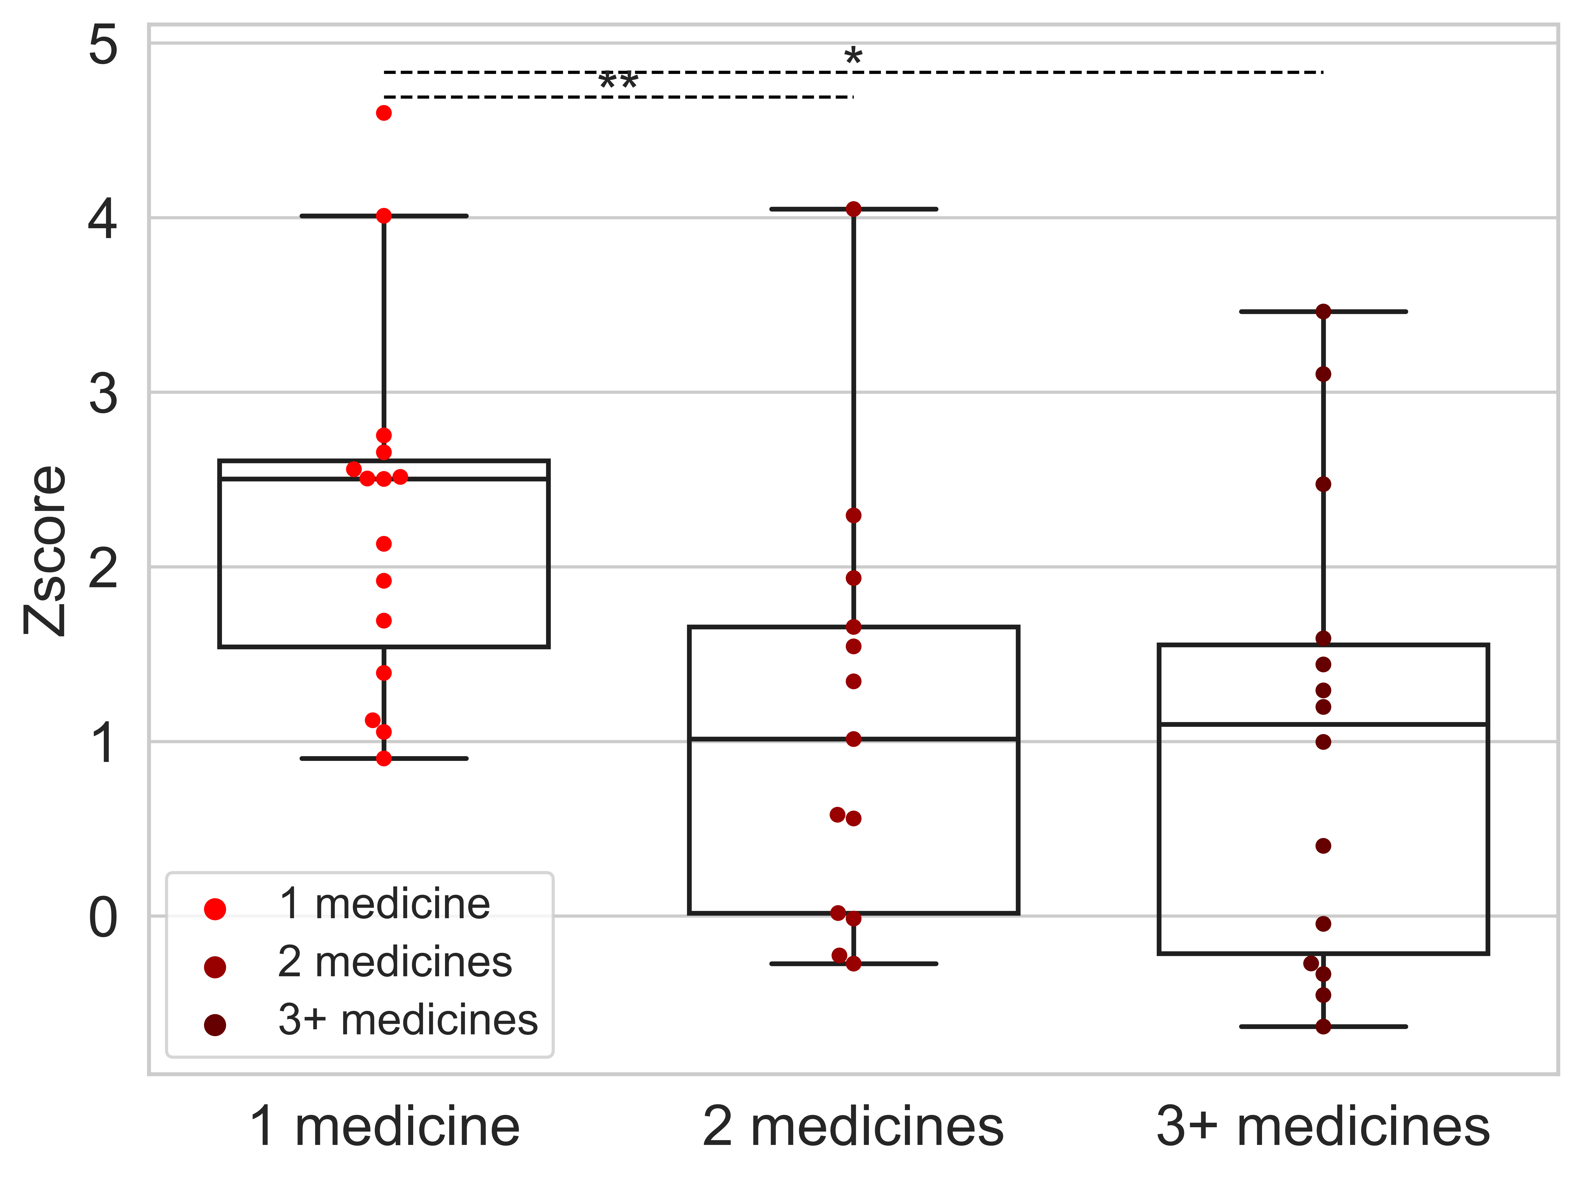
Medications

Slide 5
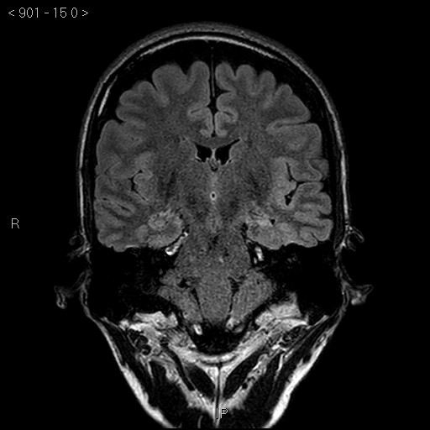
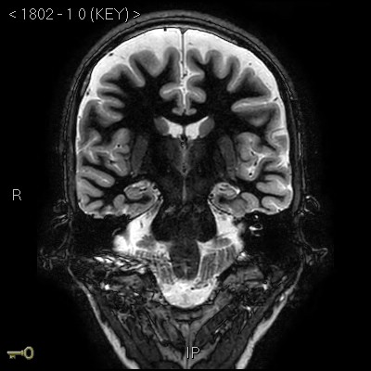
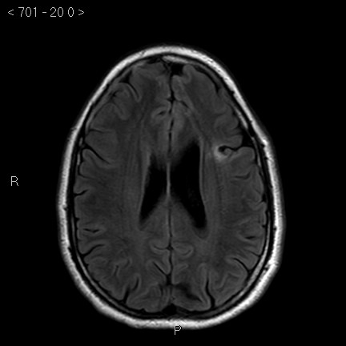
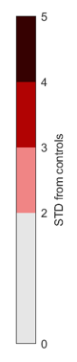
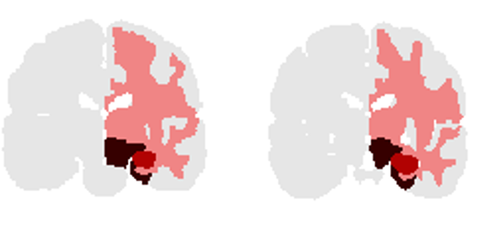

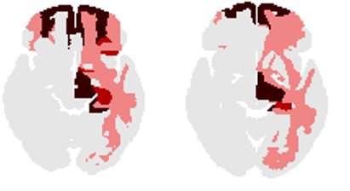
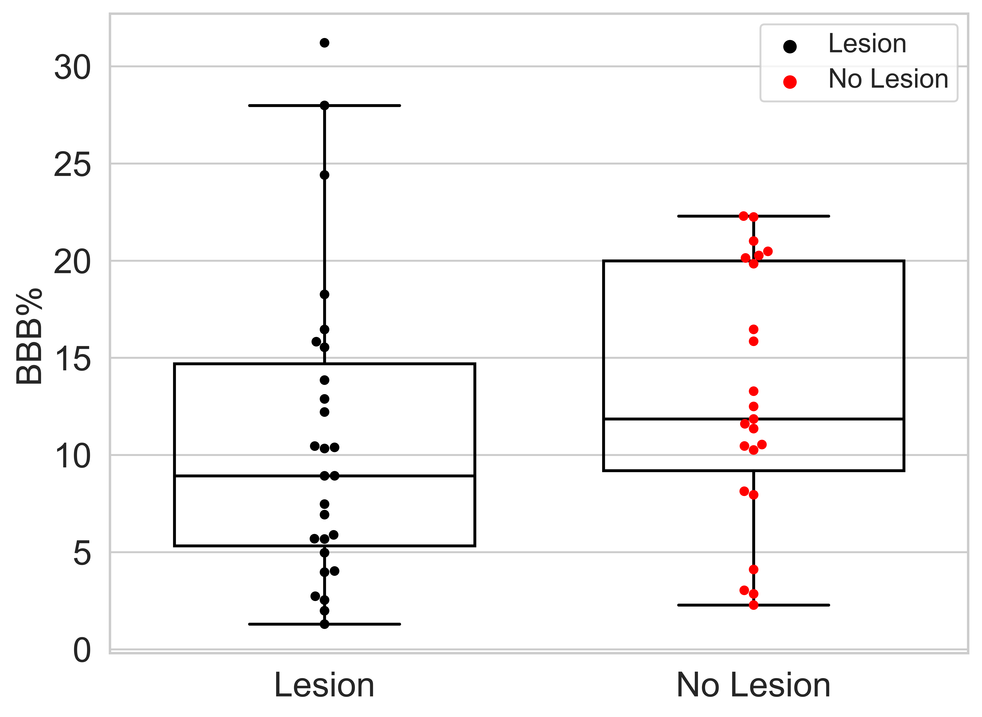
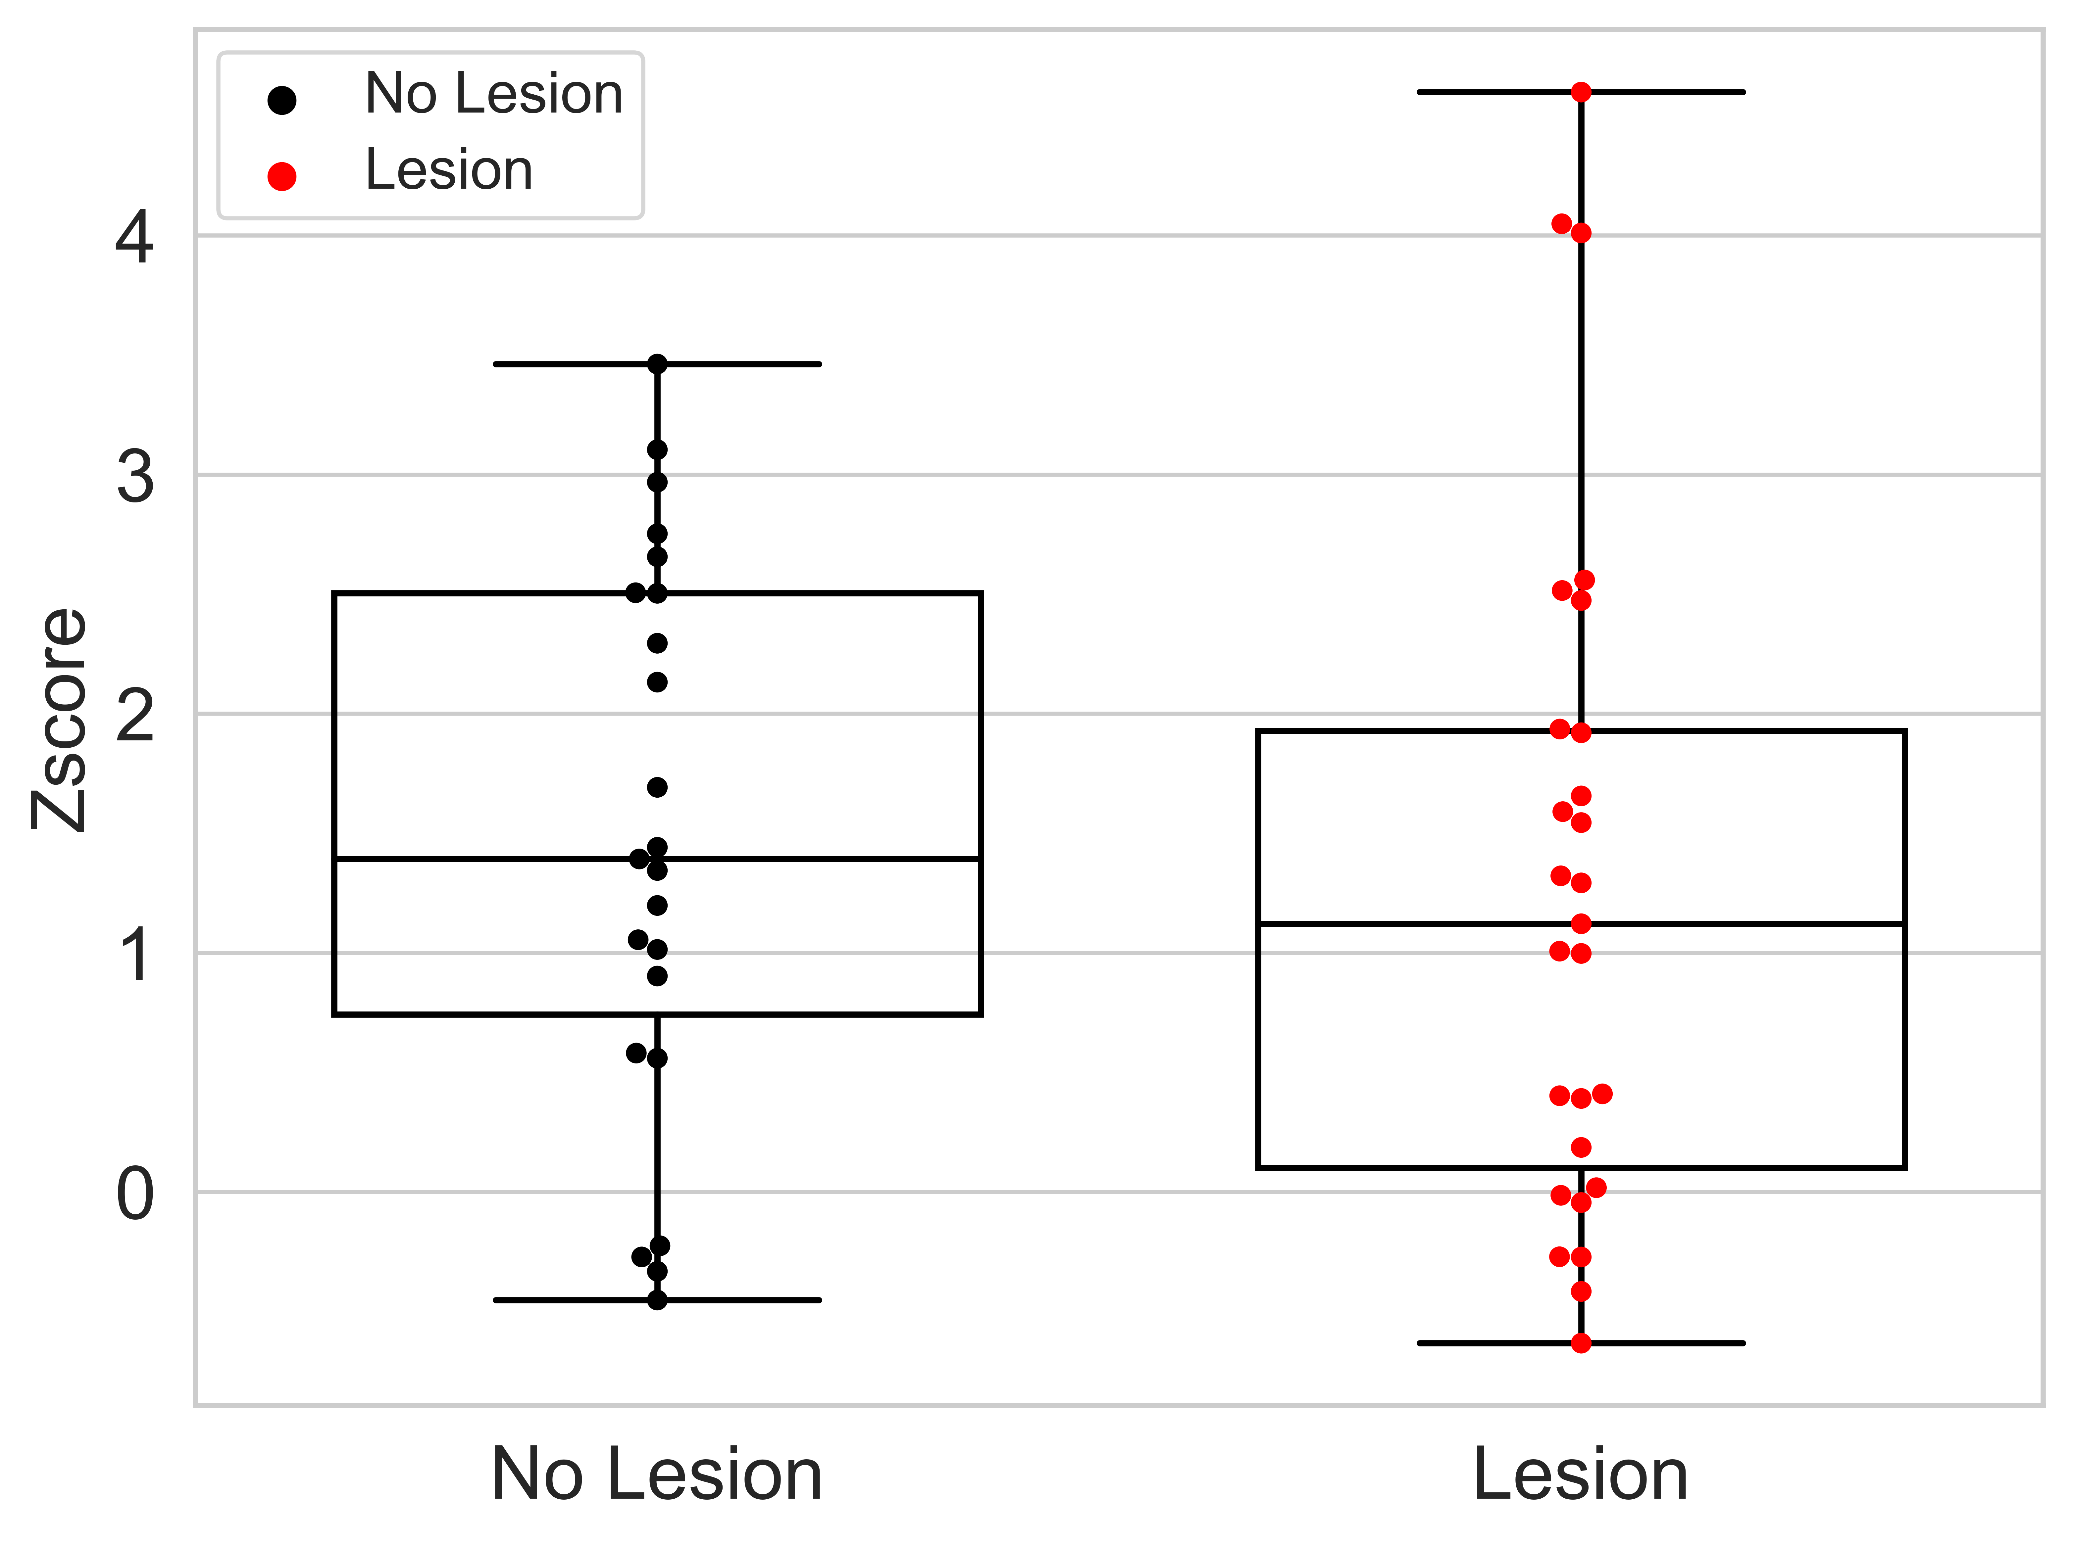
FIGURE 5: Lesion and BBBD
A Left Hippocampal Sclerosis: 35 yo man, focal epilepsy with impaired awareness, secondary generalization
B Frontal lode epilepsy: 33yo man, EEG: normal
Notes:
1 - MH_4108
2 - BT_3007
3 - TA_4648
4 - EA_0804

Slide 6
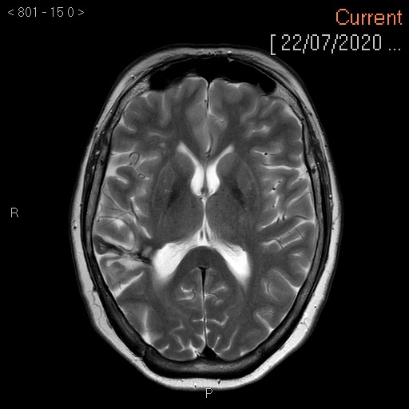
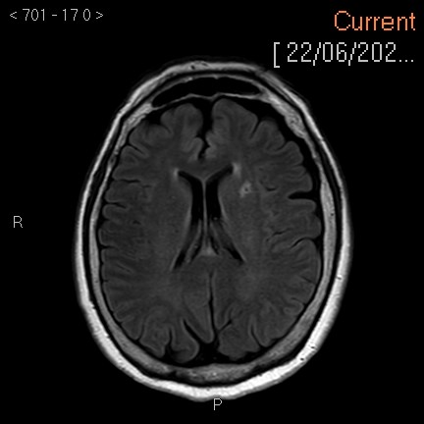
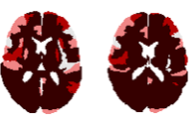


C Frontal lobe Epilepsy: 55yo woman, EEG: frontal temporal right
D M/P Cortical Dysplasia: 57yo woman, EEG: Letf fronto-temporal

Slide 7
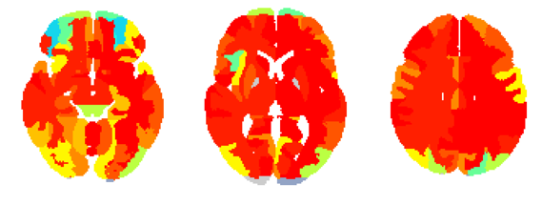
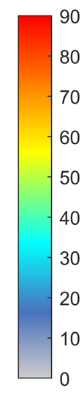
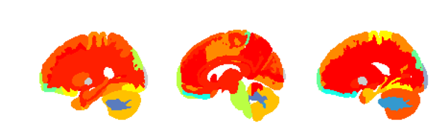
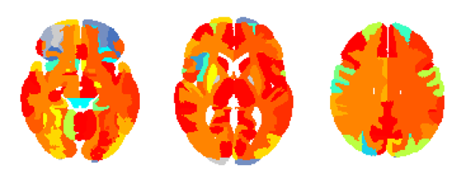
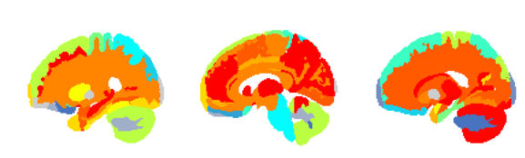
FIGURE 4: Frontal focal epilepsy
A Suspected Frontal
C
Patients with BBBD, % all
B Temporal
D
Figure 4 Focal regions are characterized with more BBBD. (A) Patients with temporal epilepsy compared to other epileptic patients in temporal regions. (B) Statistics of temporal and frontal focal epileptic patients in temporal regions. (C) Patients with frontal epilepsy compared to other epileptic patients in frontal regions. (D) Patients with frontal epilepsy compared to other epileptic patients in frontal regions.
N
Frontal epilepsy = 15
Rest epilepsy = 25
N
Temporal epilepsy = 13
Rest epilepsy = 27

Slide 8
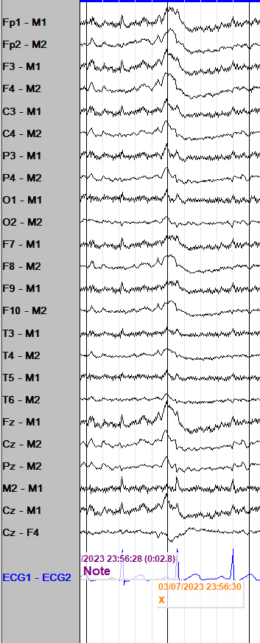
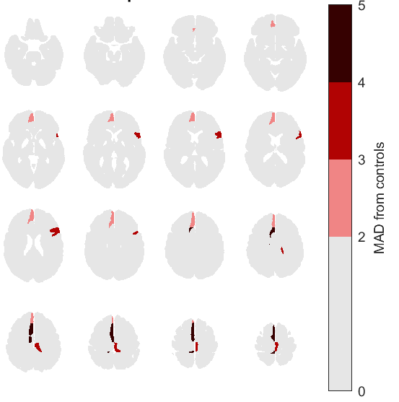
Time for translation: Preliminary (unpublished) results
Patient #1: 28-year-old male, “seizure-like episodes” during sleep. Meds: carbamazepine, divalproex, perampanel.
EMU: Complex and brief hypermotor events, vocalizing out of sleep, left arm extension and right arm flexion. Focal to bilateral tonic-clonic seizures. LTM-EEG: Interictal bifrontal spikes Rt>Lt. Ictal: right frontal midline vs bifrontal.
MRI: Non-lesional
With Ben Whatley, Dalhousie Univ / NSHA (3T GE)
Notes:
Left: Referential montage to ipsilateral mastoid (M1, M2)- bifrontal low amplitude sharp and slow wave maximal over Fp2, F4, F8, Fz
Right: Common average montage- bifrontal spikes and sharp waves
I did not receive examples for ictal patterns

Slide 9
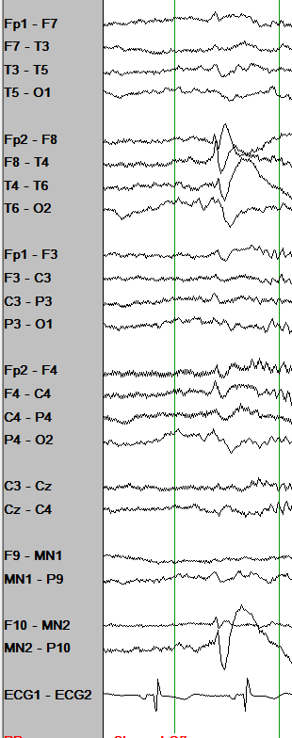
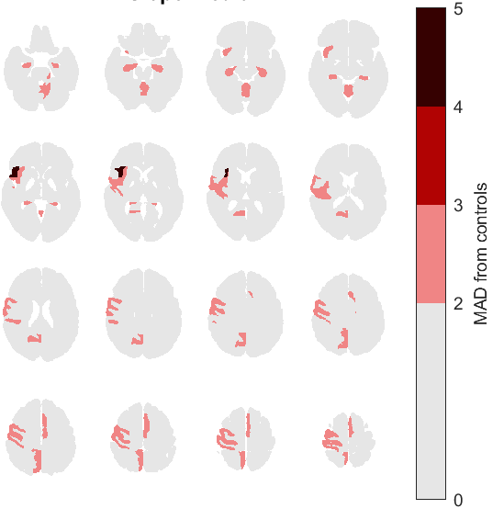
Time for translation: Preliminary (unpublished) results
Patient #2: 24-year-old female, possible right mesial temporal lobe epilepsy. Meds: brivaracetam, lamotrigine, perampanel
Interictal EEG: Right anterior temporal spikes. EMU: focal to bilateral tonic clonic seizures, semiology rMTLE
LTM-EEG: Ictal: low amplitude rhythmic delta evolving over the right anterior and mid-temporal regions
MRI: non-lesional .
With Ben Whatley, Dalhousie Univ / NSHA
Notes:
An example for the regional comparison output: Mainly frontal areas

Slide 10
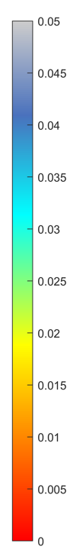
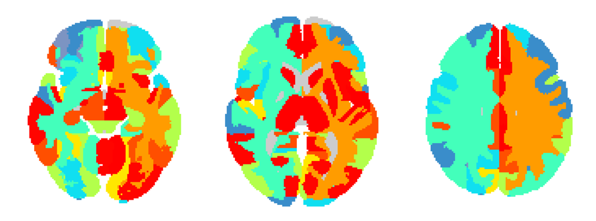
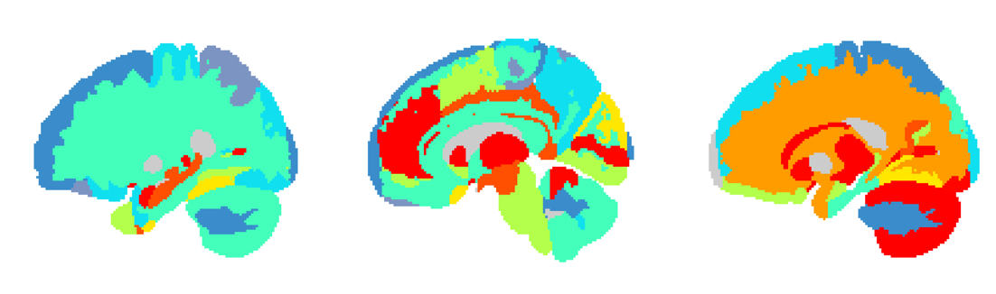
FIGURE 4: Temporal focal epilepsy
A
B
Patients with BBBD, % all
Figure 4 Focal regions are characterized with more BBBD. (A) Patients with temporal epilepsy compared to other epileptic patients in temporal regions in fast model. (B) Patients with temporal epilepsy compared to other epileptic patients in temporal regions in slow model. Temporal areas; 0: Left ITG inferior temporal gyrus, 1: Left MTG middle temporal gyrus, 2: Left PT planum temporale, 3: Left STG superior temporal gyrus, 4: Left TMP temporal pole, 5: Left TTG transverse temporal gyrus, 6: Right ITG inferior temporal gyrus, 7: Right MTG middle temporal gyrus, 8: Right PT planum temporale, 9: Right STG superior temporal gyrus, 10: Right TMP temporal pole, 11: Right TTG transverse temporal gyrus. (C) Patients with frontal epilepsy compared to other epileptic patients in frontal regions in fast model. (D) Patients with frontal epilepsy compared to other epileptic patients in frontal regions in slow model. Frontal areas; 0: Left FO frontal operculum, 1: Left FRP frontal pole, 2: Left MFC medial frontal cortex, 3: Left MFG middle frontal gyrus, 4: Left MSFG superior frontal gyrus medial segment, 5: Left OpIFG opercular part of the inferior frontal gyrus, 6: Left OrIFG orbital part of the inferior frontal gyrus, 7: Left SFG superior frontal gyrus, 8: Left TrIFG triangular part of the inferior frontal gyrus, 9: Right FO frontal operculum, 10: Right FRP frontal pole, 11: Right MFC medial frontal cortex, 12: Right MFG middle frontal gyrus, 13: Right MSFG superior frontal gyrus medial segment, 14: Right OpIFG opercular part of the inferior frontal gyrus, 15: Right OrIFG orbital part of the inferior frontal gyrus, 16: Right SFG superior frontal gyrus, 17: Right TrIFG triangular part of the inferior frontal gyrus.
N
Frontal epilepsy = 15
Rest epilepsy = 25
N
Temporal epilepsy = 13
Rest epilepsy = 27

Slide 11
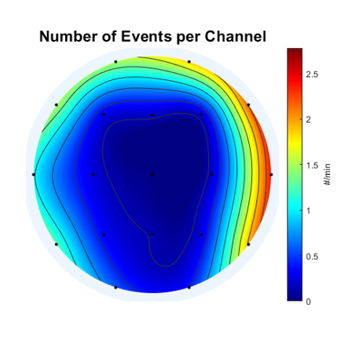



TA_4648
EA_0804

Slide 12



MH_4108
BT_3007
TA_4648
EA_0804

Slide 13
FIGURE 4: Frontal and temporal focal epilepsy
A Fast
C Fast
B Slow
D Slow
Figure 4 Focal regions are characterized with more BBBD. (A) Patients with temporal epilepsy compared to other epileptic patients in temporal regions in fast model. (B) Patients with temporal epilepsy compared to other epileptic patients in temporal regions in slow model. Temporal areas; 0: Left ITG inferior temporal gyrus, 1: Left MTG middle temporal gyrus, 2: Left PT planum temporale, 3: Left STG superior temporal gyrus, 4: Left TMP temporal pole, 5: Left TTG transverse temporal gyrus, 6: Right ITG inferior temporal gyrus, 7: Right MTG middle temporal gyrus, 8: Right PT planum temporale, 9: Right STG superior temporal gyrus, 10: Right TMP temporal pole, 11: Right TTG transverse temporal gyrus. (C) Patients with frontal epilepsy compared to other epileptic patients in frontal regions in fast model. (D) Patients with frontal epilepsy compared to other epileptic patients in frontal regions in slow model. Frontal areas; 0: Left FO frontal operculum, 1: Left FRP frontal pole, 2: Left MFC medial frontal cortex, 3: Left MFG middle frontal gyrus, 4: Left MSFG superior frontal gyrus medial segment, 5: Left OpIFG opercular part of the inferior frontal gyrus, 6: Left OrIFG orbital part of the inferior frontal gyrus, 7: Left SFG superior frontal gyrus, 8: Left TrIFG triangular part of the inferior frontal gyrus, 9: Right FO frontal operculum, 10: Right FRP frontal pole, 11: Right MFC medial frontal cortex, 12: Right MFG middle frontal gyrus, 13: Right MSFG superior frontal gyrus medial segment, 14: Right OpIFG opercular part of the inferior frontal gyrus, 15: Right OrIFG orbital part of the inferior frontal gyrus, 16: Right SFG superior frontal gyrus, 17: Right TrIFG triangular part of the inferior frontal gyrus.
N
Frontal epilepsy = 11
Rest epilepsy = 18
N
Temporal epilepsy = 9
Rest epilepsy = 20

Slide 14
Frontal Vs Rest

Slide 15
Frontal Vs Rest

Slide 16




FIGURE 5: PSWE and BBBD
ME 4933
TA 4648

Slide 17



HY9719 Slow Fast

Slide 18
FIGURE 4: Temporal vs Frontal
D
A
B
C
D
N
Temporal epilepsy = 8
Rest epilepsy = 26
N
Frontal epilepsy = 10
Rest epilepsy = 24
Notes:
Theories:
* Generalized is a type of focal

Slide 19
FIGURE 4: Temporal vs Frontal
D
A
B
C
D
N
Temporal areas = 10
Other areas = 126
Notes:
Theories:
* Generalized is a type of focal

Slide 20
N
Patients with lesions– 13
Notes:
Theories:
* Generalized is a type of focal

Slide 21





















A CONTROLS
C STATISTICS
0 slow 0.1
Fast
0 fast 0.1
Slow
D METHOD
B EPILEPSY
PWE 1 2 3 4
Fast
STD above controls
Slow
Figure 1 DCE-MRI reveals persistent BBBD in epileptic patients. (A) Examples of controls without BBBD, with fast BBBD and slow BBBD. (D) Examples of patients with epilepsy without BBBD, with fast BBBD and slow BBBD and both fast and slow BBBD. (C) Epileptic patients' statistics compared to controls. (D) BBBD analysis method
Notes:
CONTORLS:
PN_8563
HS_5404
CM_8261
Epilepsy
IE_2899
BT_3007
MB_1437

